Slide 1
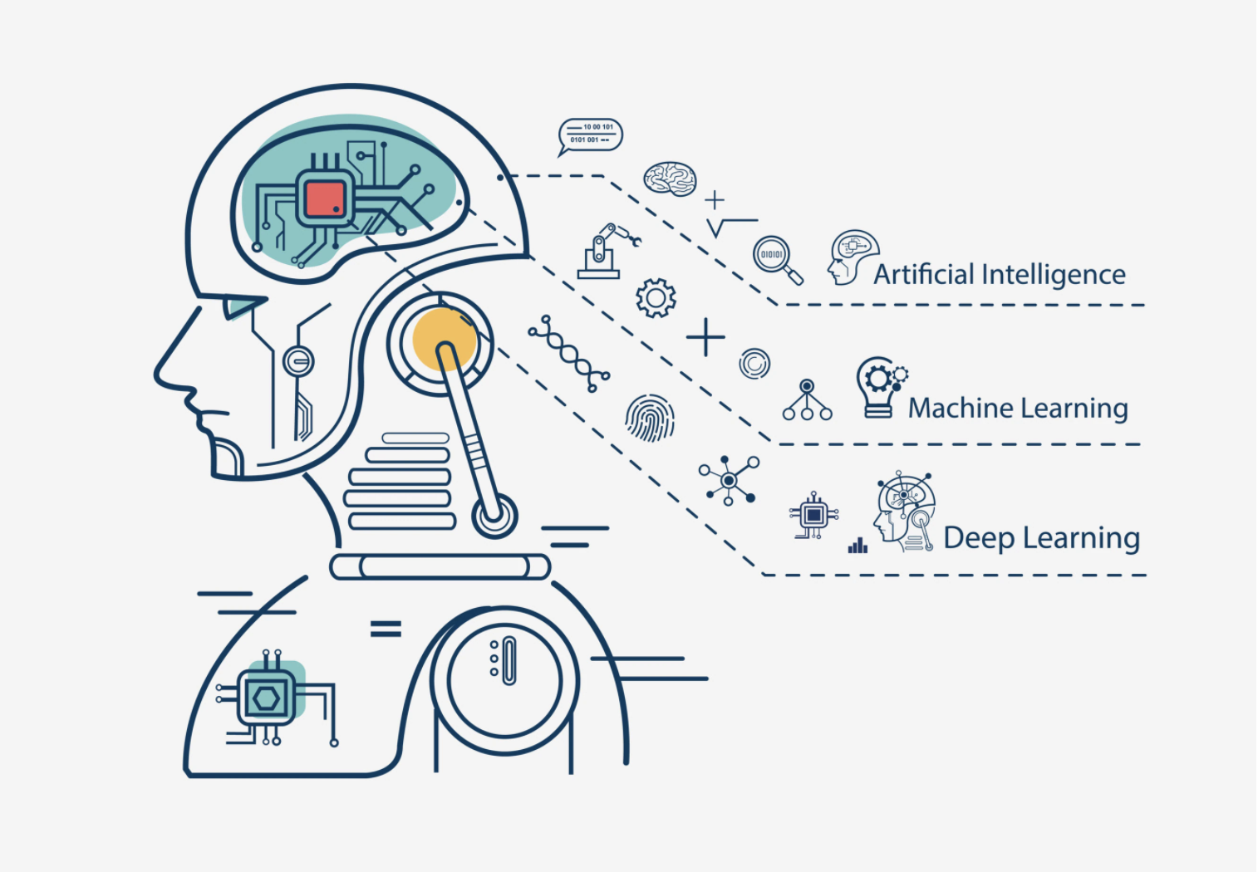
Hand Gesture Recognition
Ayush Kumar Jha(19105051)
Aman Singla(19105028)
Sudeep Dhara(19105011) Ashish Ranjan(19105049)
Akshit Maheshwari(19105029)
Kshitij Jain(19105100)
Gurnoor singh(19105046)

Slide 2
AIM of this project
Being a significant part in non verbal communication hand gestures are playing vital role in our daily life
Gesture Recognition has a large area of application for example in human machine interaction, sign language interpreter (for visually impaired people) , immersive game technology and many more.
A normal human hand shape have a thumb and four fingers and by keeping in mind the picture of an alike of a human hand we will try to present a real time system for the recognition of hand gesture which will be on the basis of the training set or data which will be given in input on shape based features which would be like orientation of hand, status of fingers (open or closed), thumb in terms of raised or folded fingers of hand and their respective location in image.

Slide 3
AIM of this project (cont.)
The approach we used in this project simply takes into account the shape of the hand and not the skin colour
To implement this algorithm we have utilized a simple web cam of the laptop.
This algorithm based approach for hand gesture recognition can identify many different gestures on the bases of training data set we give to it.

Slide 4
About the project
A gesture is defined as the motion of the body by the user in order to convey some meaningful information.
Gesture recognition is the process by which gesture shown by the user is identified by the system
With the advancement of current user machine interaction tools and components including keyboard, joystick, mouse are not sufficient. Thus to provide a more genuine interface to the computer system, hand gestures are used to represent different shapes which is identified by the gesture recognition system.

Slide 5
About the project (cont.)
This can also be used by people who cannot speak to communicate to other people.
This technology can also be used in computer games and make the playing environment completely hands free that is without the use of any joystick, keyboard or mouse

Slide 6
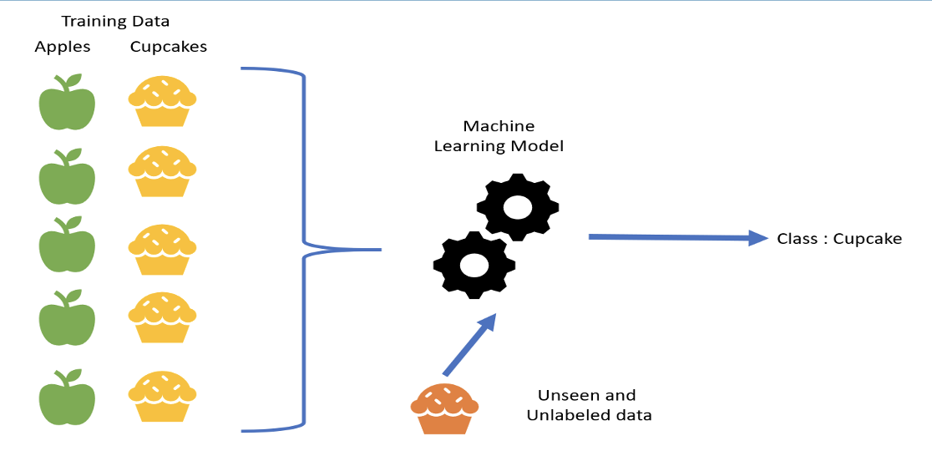
Supervised learning and machine learning

Slide 7
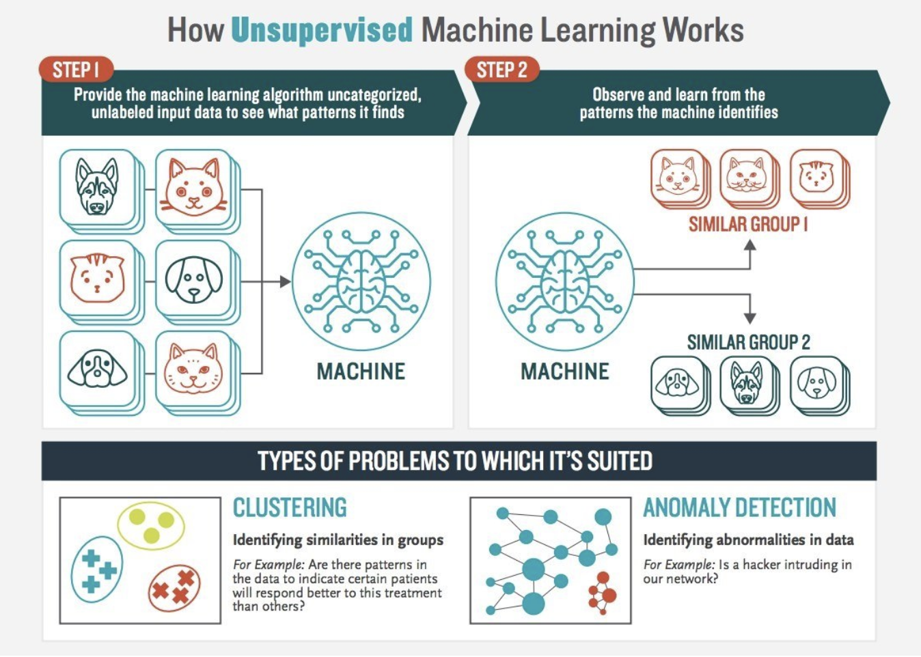
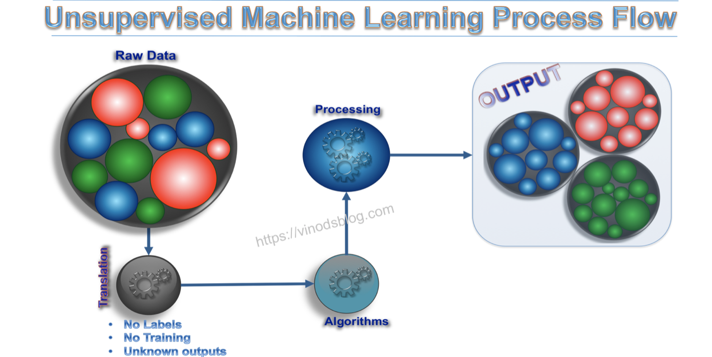
Unsupervised learning

Slide 8
Convolutional neural network
A Convolutional Neural Network, also known as CNN or ConvNet, is a class of neural networks that specializes in processing data that has a grid-like topology, such as an image.
The architecture of a ConvNet is analogous to that of the connectivity pattern of Neurons in the Human Brain and was inspired by the organization of the Visual Cortex. Individual neurons respond to stimuli only in a restricted region of the visual field known as the Receptive Field. A collection of such fields overlap to cover the entire visual area

Slide 9
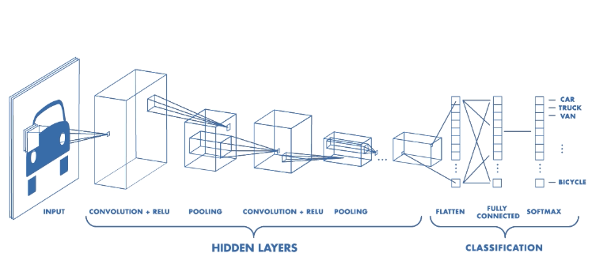
Convolutional Neural Network Architecture
A CNN typically has three layers: a convolutional layer, a pooling layer, and a fully connected layer.

Slide 10
Convolution Layer
This layer performs a dot product between two matrices, where one matrix is the set of learnable parameters otherwise known as a kernel, and the other matrix is the restricted portion of the receptive field. The kernel is spatially smaller than an image but is more in-depth.

Slide 11
Convolution Layer (cont.)
During the forward pass, the kernel slides across the height and width of the image-producing the image representation of that receptive region. This produces a two-dimensional representation of the image known as an activation map that gives the response of the kernel at each spatial position of the image. The sliding size of the kernel is called a stride.

Slide 12
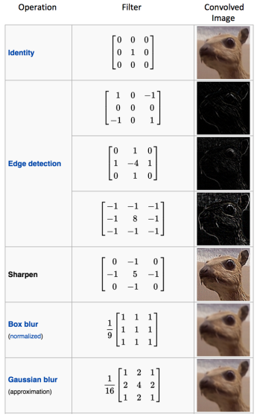
Sample Filters

Slide 13
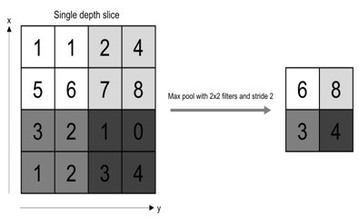
Pooling layer
The pooling layer replaces the output of the network at certain locations by deriving a summary statistic of the nearby outputs. This helps in reducing the spatial size of the representation.
There are several pooling functions such as the average of the rectangular neighborhood, L2 norm of the rectangular neighborhood, and a weighted average based on the distance from the central pixel.

Slide 14
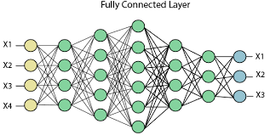
Fully Connected Layer
Neurons in this layer have full connectivity with all neurons in the preceding and succeeding layer as seen in regular FCNN. This is why it can be computed as usual by a matrix multiplication followed by a bias effect.
The FC layer helps to map the representation between the input and the output.

Slide 15
Non-Linearity Layers
Since convolution is a linear operation and images are far from linear, non-linearity layers are often placed directly after the convolutional layer to introduce non-linearity to the activation map.
There are several types of non-linear operations, the popular ones being:
Sigmoid:
The sigmoid non-linearity has the mathematical form σ(κ) = 1/(1+e¯κ). It takes a real-valued number and “squashes” it into a range between 0 and 1.
Tanh
Tanh squashes a real-valued number to the range [-1, 1].
ReLU
It computes the function ƒ(κ)=max (0,κ). In other words, the activation is simply threshold at zero

Slide 16
Applications of CNN
Object detection: With CNN, we now have sophisticated models like R-CNN, Fast R-CNN, and Faster R-CNN that are the predominant pipeline for many object detection models deployed in autonomous vehicles, facial detection, and more.
Semantic segmentation: In 2015, a group of researchers from Hong Kong developed a CNN-based Deep Parsing Network to incorporate rich information into an image segmentation model. Researchers from UC Berkeley also built fully convolutional networks that improved upon state-of-the-art semantic segmentation.
Image captioning: CNNs are used with recurrent neural networks to write captions for images and videos. This can be used for many applications such as activity recognition or describing videos and images for the visually impaired. It has been heavily deployed by YouTube to make sense to the huge number of videos uploaded to the platform on a regular basis.

Slide 17
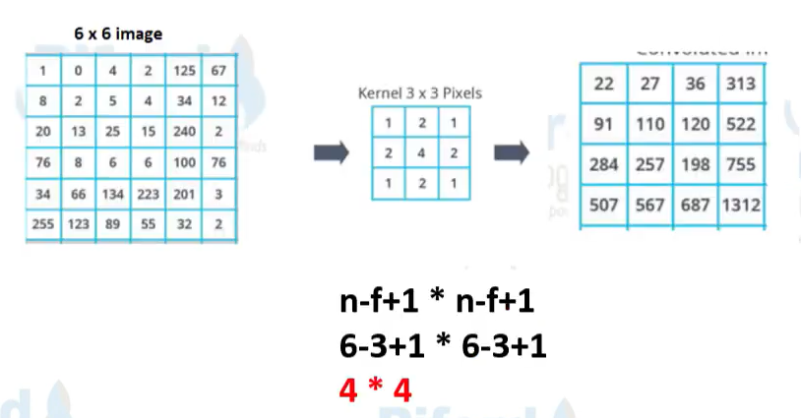
Without Padding

Slide 18
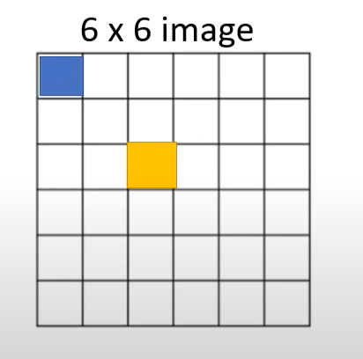
Padding

Slide 19
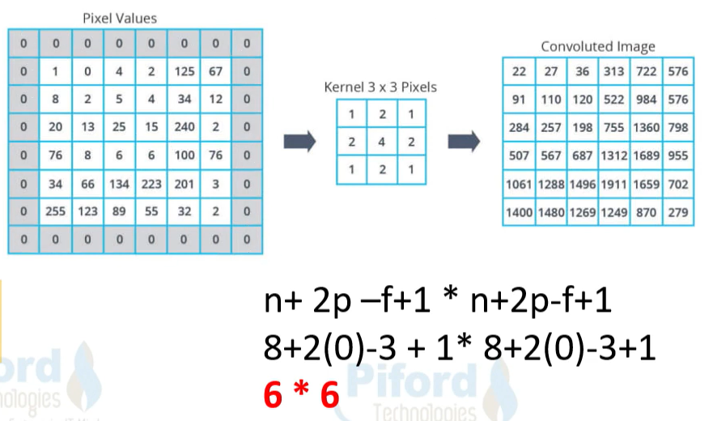
Padding (cont.)

Slide 20
Alexnet
AlexNet is one of the most popular CNN architectures.
AlexNet architecture consists of 5 convolutional layers, 3 max-pooling layers, 2 fully connected layers, and 1 softmax layer.
Each convolutional layer consists of convolutional filters and a nonlinear activation function ReLU.
The pooling layers are used to perform max pooling.
Input size is fixed due to the presence of fully connected layers.
The input size is mentioned at most of the places as 224x224x3 but due to some padding which happens it works out to be 227x227x3

Slide 21
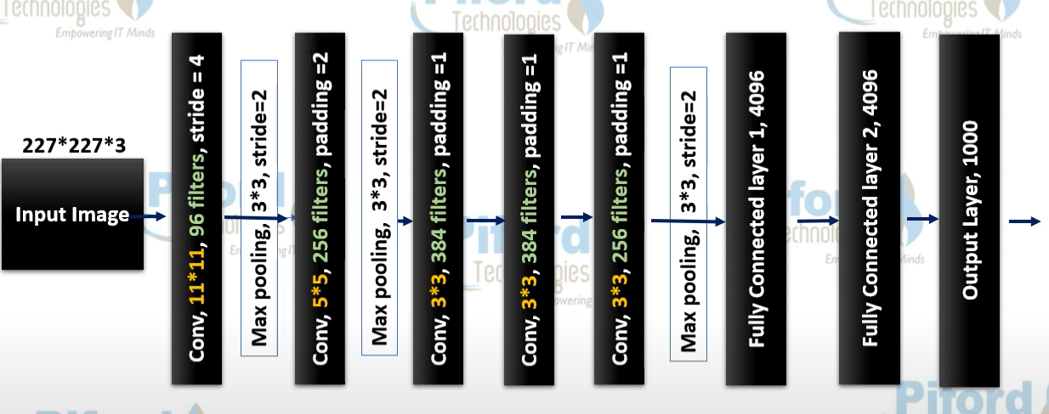
Alexnet layers

Slide 22
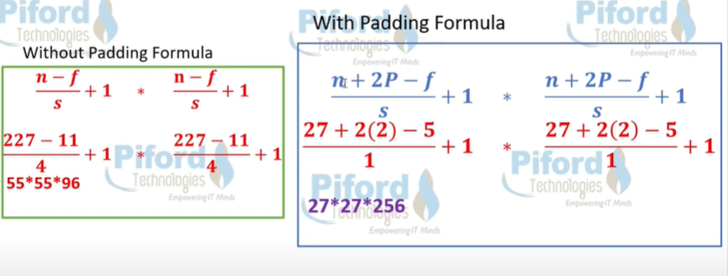
Alexnet layers

Slide 23
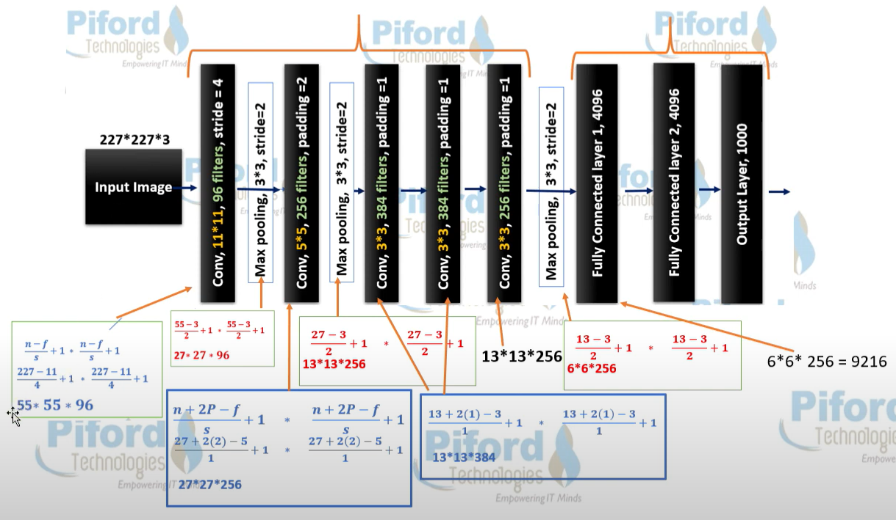
Alexnet layers

Slide 24
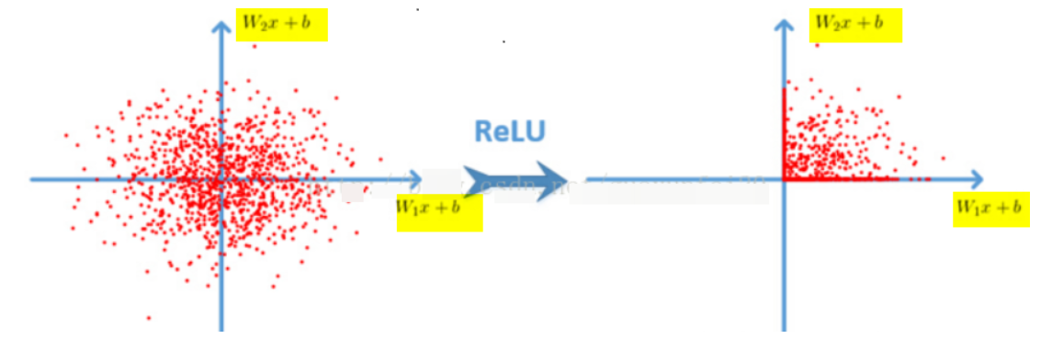
Why Alexnet ?
Relu function: f (x) = max (0, x)
ReLU-based deep convolutional networks are trained several times faster than tanh and sigmoid- based networks.
Relu function: f (x) = max (0, x)

Slide 25
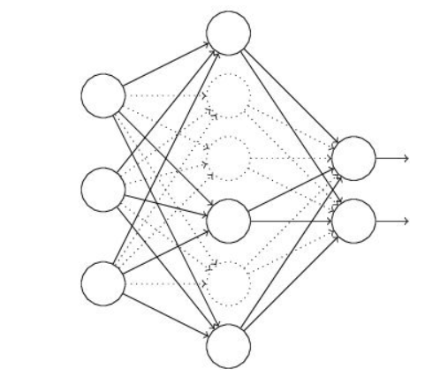
Why Alexnet ?
Dropout
Dropout is also a concept often said, which can effectively prevent overfitting of neural networks. Compared to the general linear model, a regular method is used to prevent the model from overfitting. In the neural network, Dropout is implemented by modifying the structure of the neural network itself. For a certain layer of neurons, randomly delete some neurons with a defined probability, while keeping the individuals of the input layer and output layer neurons unchanged, and then update the parameters according to the learning method of the neural network. In the next iteration, rerandom Remove some neurons until the end of training.

Slide 26
Why Alexnet ?
Enhanced Data ( Data Augmentation )
In deep learning, when the amount of data is not large enough, there are generally 3 solutions:
Data augmentation- artificially increase the size of the training set-create a batch of "new" data from existing data by means of translation, flipping, noise.
Regularization - The relatively small amount of data will cause the model to overfit, making the training error small and the test error particularly large. By adding a regular term after the Loss Function , the overfitting can be suppressed. The disadvantage is that a need is introduced Manually adjusted hyper-parameter.
Dropout- also a regularization method. But different from the above, it is achieved by randomly setting the output of some neurons to zero

Slide 27
Code and Dataset
There are 3 code files in our project used for different purposes:
Data Collection Code
Training Code
Testing Code

Slide 28
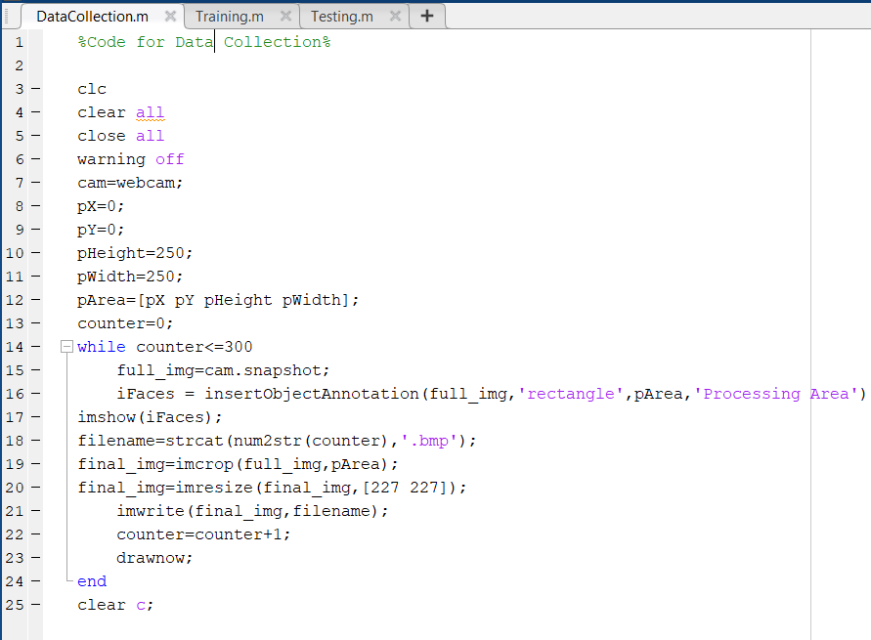
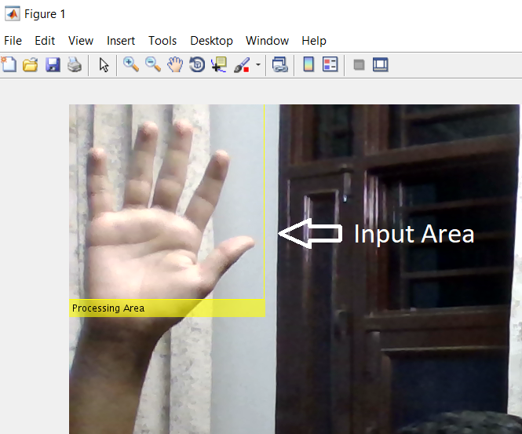
Data Collection Code

Slide 29
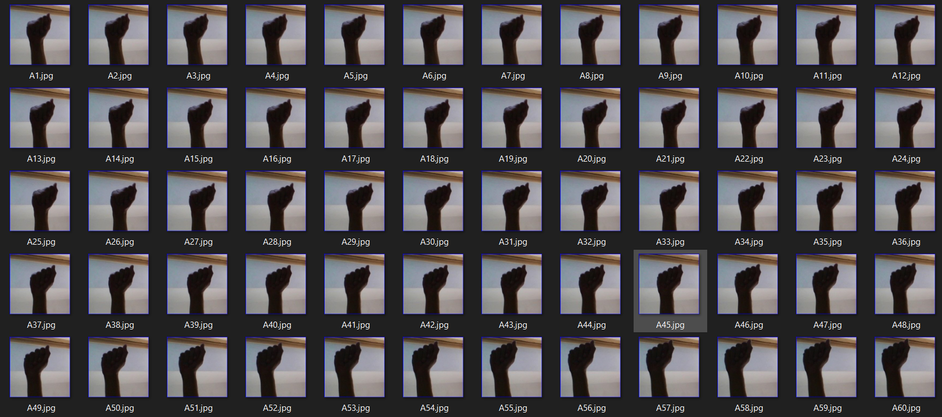
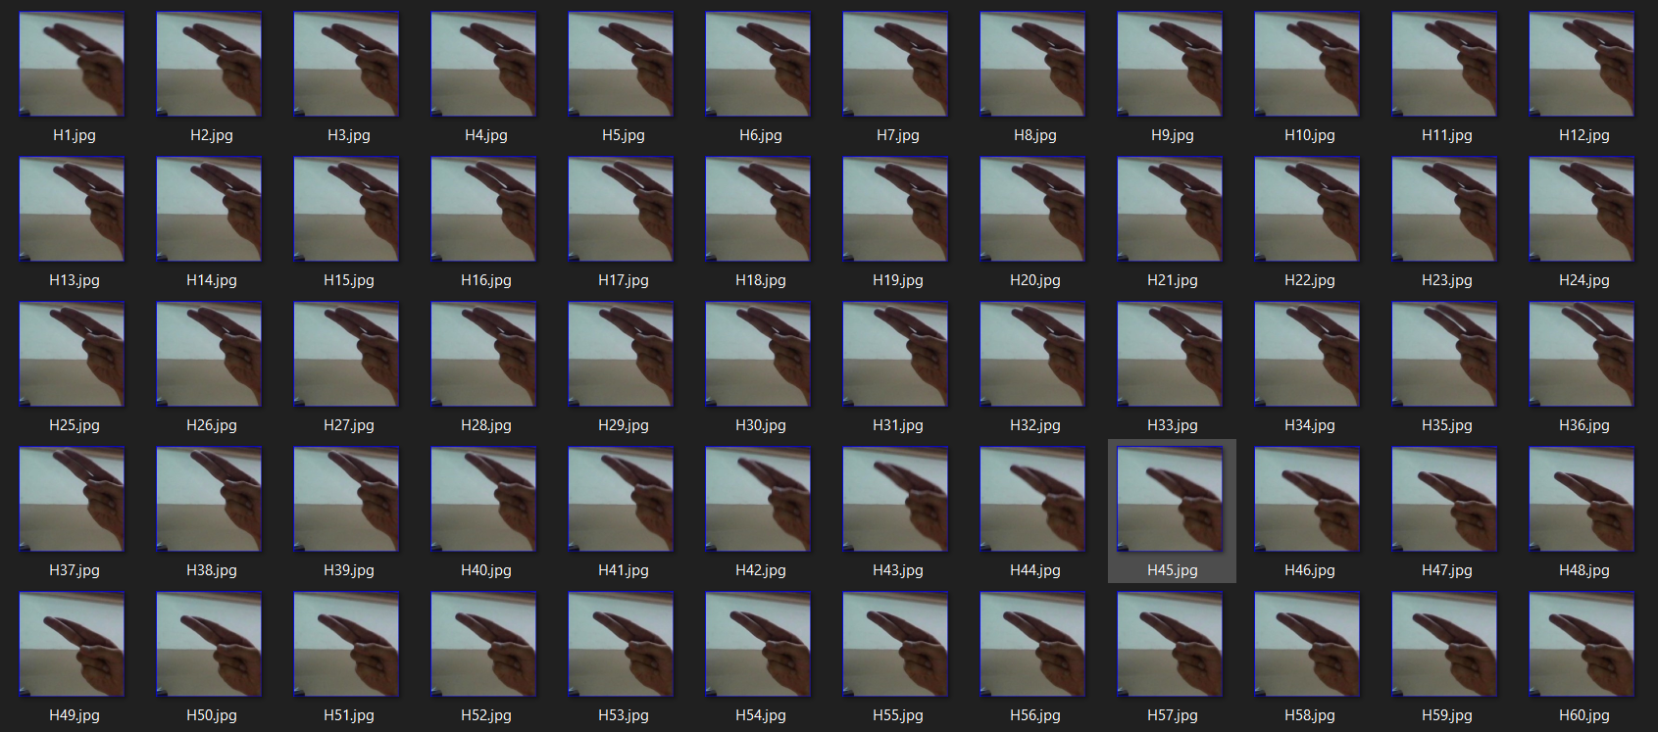
Dataset Images

Slide 30
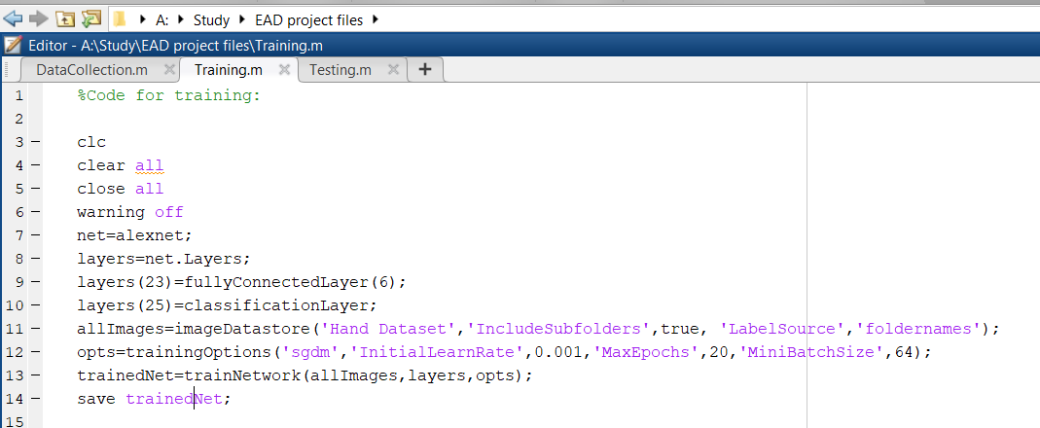
Training Code

Slide 31
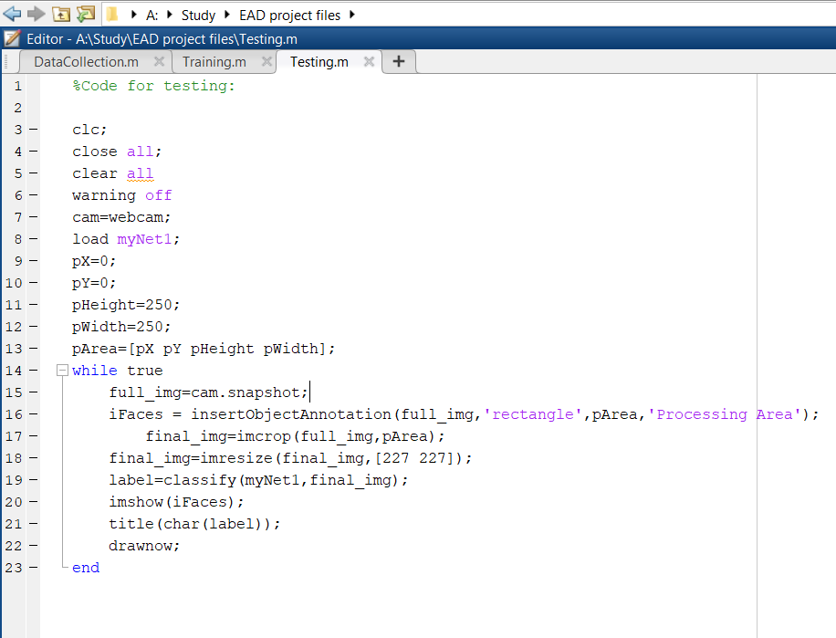
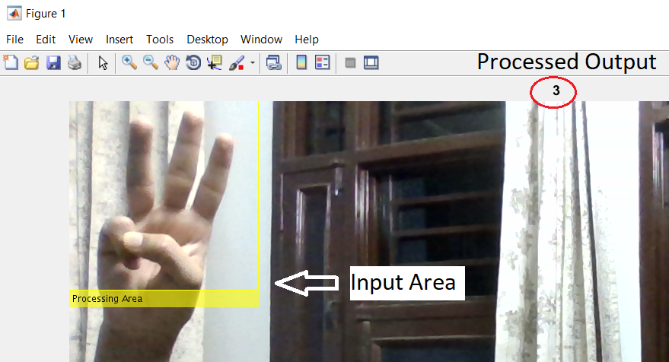
Testing Code

Slide 32
Limitations or Difficulties faced
As we know that for CNN or for training the system we need huge data and quality data for proper analysis or outcome so we faced a little bit problem regarding collection of our dataset or imageset.
As we have used a significant amount of data or images for analysis so it takes a noticeable time for training the system to achieve required accuracy.
We also faced a little bit of problem regarding blurred or the images which don’t have proper resolution or orientation.

Slide 33
Future scope
Hand Gesture Recognition techniques are developing at a tremendous speed and many big companies are trying to add these features in their products and services.
We are trying to :-
Using more sophisticated machine learning techniques.
Enhance the recognition capabilities for various conditions.
Achieving more accuracy, memory efficiency.

Slide 34
Future scope (contd.)
Running the device with least power.
Identifying multiple number of gestures.
To improve our project and research further we are going to add few more things to our current work, as it is now capable of analysing or recognizing static gestures we are planning to add on features regarding or training the system to understand Dynamic Hand Gesture Motions which will make it more effective.

Slide 35
References
Meenakshi Panwar and Pawan singh Mehra , “Hand Gesture Recognition for Human
Computer Interaction”.
Raimundo F. pinto, Carlos D.B. Borges , Antonio almeida , “Static Hand Gesture
Recognition Based on Convolutional Neural Networks”.
Felix Zhan , “Hand Gesture Recognition using Convolution Neural Network ”, IEEE.
Oyebade k. Oyedotum , and Adnan Khashman , “Deep learning in Vision Based Static
Hand Gesture Recognition ”.
Xiaohui Shen , Gang Hua, Lance williams Ying yu “Dynamic hand gesture recognition:
An exemplar-based approach from motion divergence fields”.
Yung Wu and Thomas Huang - “Vision Based Gesture Recognition”
Simran Shah, Ami Kotia, and Kausha Nisar, “A Vision Based Hand Gesture Recognition
System Using Convolutional Neural Networks”, researchgate,2019.

